Slide 1

The Reverse Prism
The Starks
Akshaya Balamurugan (A0178458L)
Gananathan Khoteeswarun (A0178328U)
Monisha Prasad (A0178265U)
Venkateswara Venkata Krishnan (A0178343Y)

Slide 2
What do you think ?
Cambridge Analytica
Singapore Trump-Kim Summit
Syrian Civil War

Slide 3

How do you know ?
Radio ? (seriously )
Television ?
Facebook ?
Mobile Apps ?
Online News channels ?

Slide 4
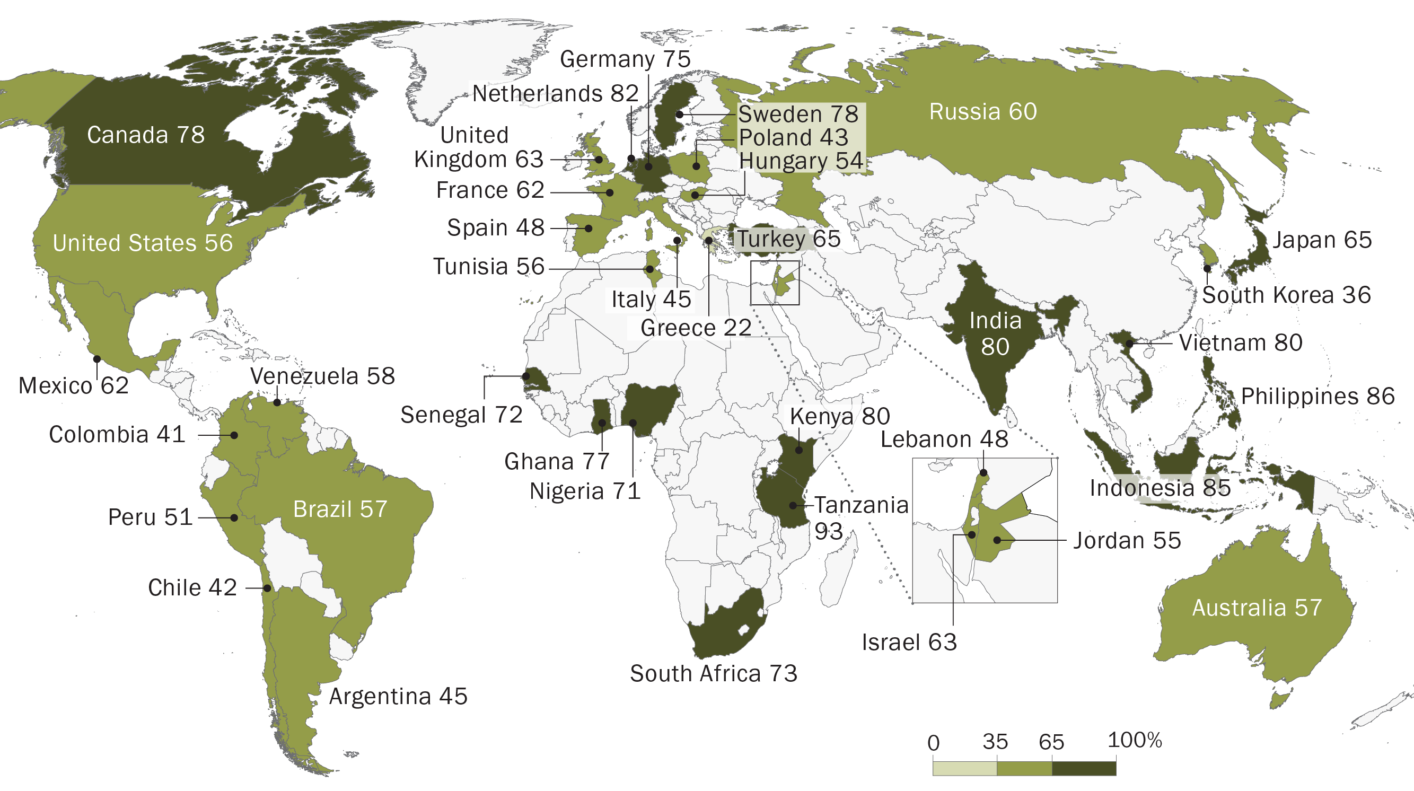
News % who say their news media are doing very/somewhat well at reporting
http://www.pewglobal.org/2018/01/11/publics-globally-want-unbiased-news-coverage-but-are-divided-on-whether-their-news-media-deliver/

Slide 5
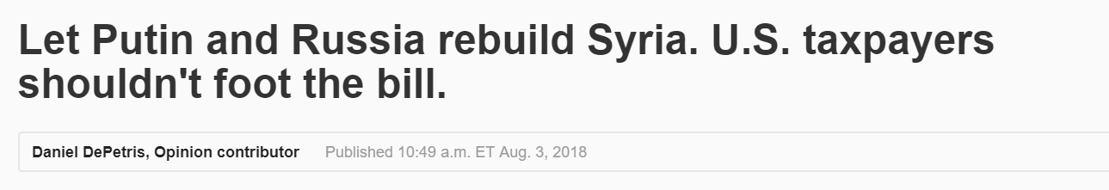

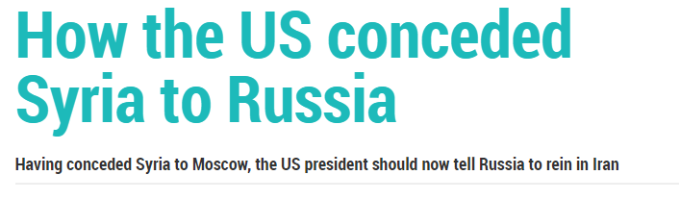
One News.. Many Views..

Slide 6
What is right ?
Read
from multiple sources
Understand
from valid articles
Perceive
the “RIGHT” information

Slide 7

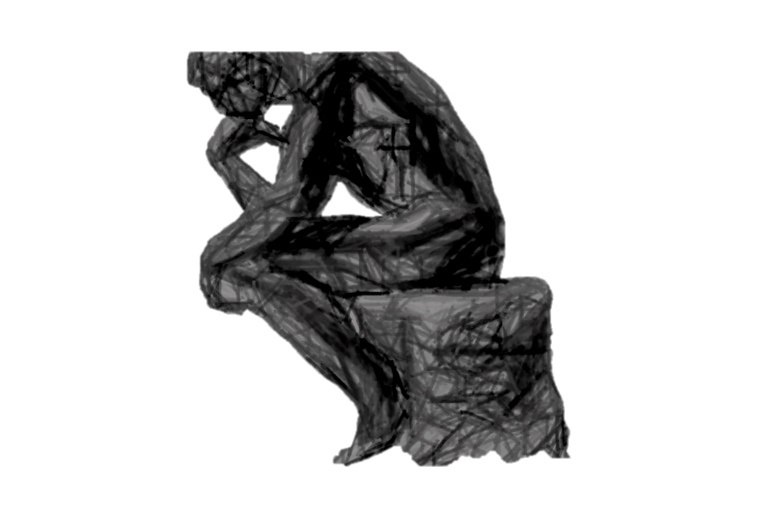
The Rough Numbers
Can we automate ?
Searching for a single keyword will result in
Number of websites (assumption – selective sites) | 20
Number of articles per website | 7-10
Number of articles overall | ~180

Slide 8
What Where & How?
Read What
Online News Articles (Header, Content & Time)
From Where
20 New websites from 11 different regions
Perceive How
Scrape the articles
Parse the contents
Analyse

Slide 9
The Database
Homepages | Scraped URL Log | Articles | Insights
_id – Object ID | _id – Object ID | _id – Object ID | _id – Object ID
Region - String | keyword – String | URL – string | URL – string
Homepages – Array of Strings | log_time – ISODate | Header – string | Parent_keyword – String
 | URLs - Array of Objects. | Content – string | Region – String
 |  | Time – String | Keywords – Array of Strings
 |  | Parent_keyword - String | Summary – String
 |  | Scraped_time – ISODate | Polarity – number
 |  |  | Subjectivity - number

Slide 10
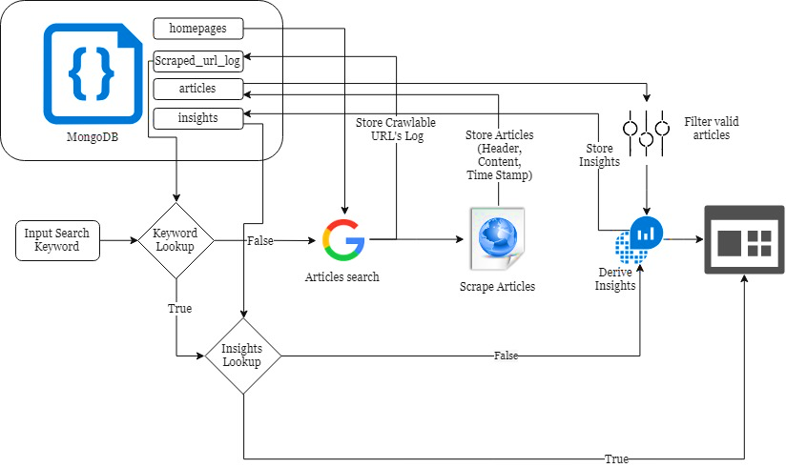






Scraping Setup
bs4
Tech Tool Kit

Slide 11
Challenge !!
Generalizing 20 different websites
Google Bot blocks/ Firewall Blocks
When was it scraped ?

Slide 12
Analysis
Basic Filtering
Keyword Extraction
Summarizer
Polarity
Subjectivity
Articles per “most used keywords”

Slide 13
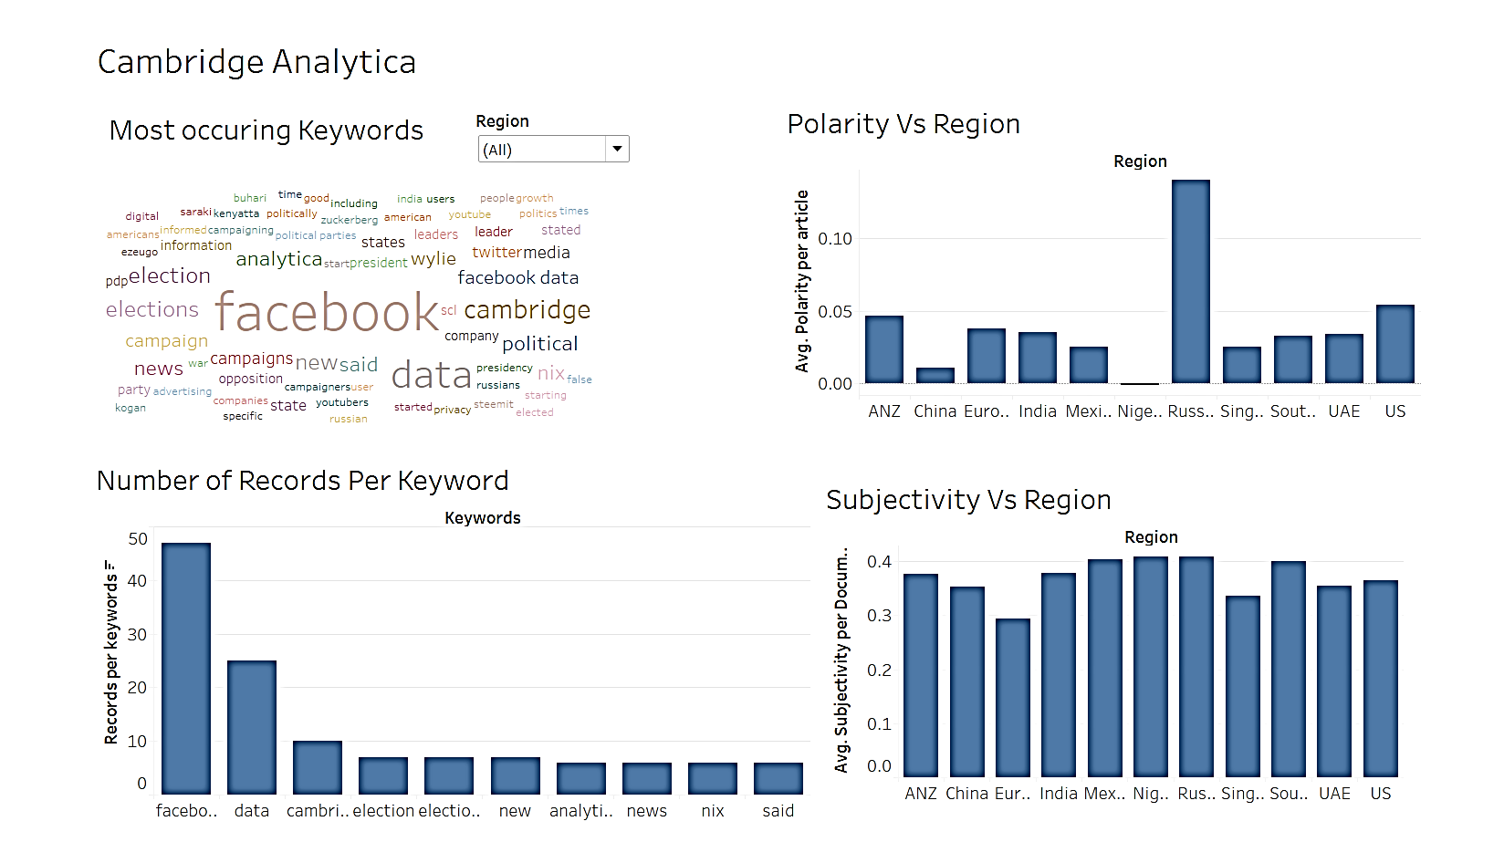
Dashboard

Slide 14
The Future..
Text Pre-processing
Text Clustering and Categorization to filter irrelevant contents
Analyse over a period of time for same keyword
Image/Video Extraction

Slide 15
Thank You !

